Slide 1
Real-Time Communications
Dr. RAJIB MALL
Professor
Department Of Computer Science & Engineering
IIT Kharagpur.

Slide 2
Organization
  Introduction
  Basic Concepts
    Types of Real-time Communication
    Types of Real-time Networks
    Quality of Service
  Soft Real-Time Communication in a LAN
  Hard Real-Time Communication in a LAN
  Real-Time Communication Over Packet Switched Networks
  Summary

Slide 3
Introducion
Real-time communication occurs when
An application can make specific quality of service demands on the underlying communication network
  maximum permissible delay
  maximum loss rate, etc.;
Once the network accepts a connection request,
it guarantees the requested service quality.

Slide 4
Introduction
Cont….
Network protocols such as Ethernet provide ``best effort'' performance.
  A best effort network strives to achieve good average
  performance,
  makes no attempt to meet the individual quality of service requirements
These networks are used in applications where
  long delays and high data loss under heavy load conditions are acceptable.

Slide 5
Types of Real-time Communication
In hard real-time communication
  unless an absolute delay bound is met, the communication is assumed to have failed.
In a firm real-time communication
  if occasionally a message is delayed,
  the delayed message is merely discarded, without affecting the system to any great extent.
  usually required in multimedia applications.

Slide 6
Examples of Applications Requiring Real-Time Communication
Manufacturing Automation
Automated Chemical Factory
Internet-based Banking Applications
Multimedia Multicast
Internet Telephony

Slide 7
Basic Concepts
Based on network size, three types real-time communication networks:
  Controller Area Networks (CANs),
  Local Area Networks (LANs),
  packet-switched networks.

Slide 8
Controller Area Network
A CAN is a very small network.
CANs are typically used to connect the different components of an embedded controller.
The end-to-end length of a CAN is usually less than 50 meters.
Since, the propagation time of a CAN is very small,
  functionally a CAN behaves more like a local bus in a computer.

Slide 9
LAN
A local area network (LAN) is typically deployed in a building or a campus and is usually privately owned.
LANs typically operate at data rates exceeding 10Mbps
  many present day LANs (gigabit Ethernets) operate at 1 Gbps.

Slide 10
Basic LAN Topologies
Local area networks are interconnected using one of four basic configurations:
1. Bus
2. Tree
3. Star
4. Wireless

Slide 11
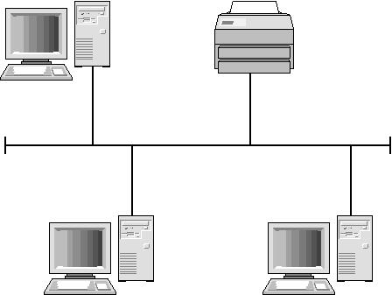
Bus Topology
Failure or removal of a device does not cause the network to fail.

Slide 12
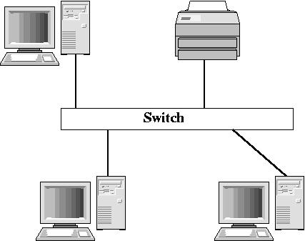
Star Topology
Failure of the hub can bring down an entire network.

Slide 13
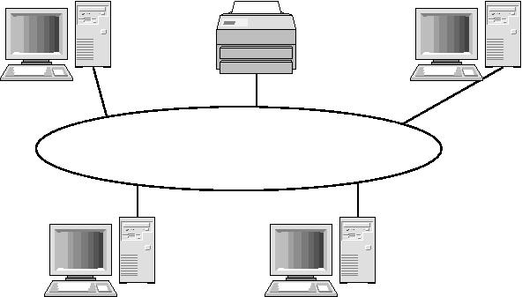
Ring Topology

Slide 14
Wireless Topology
Not really a specific topology
a workstation in a wireless LAN can be anywhere as long as it is within transmitting distance to an access point.
Several versions of IEEE 802.11 standard defines various forms of wireless LAN connections.

Slide 15
MAN
May be a single network such as a cable TV network or made up of many LANs
The high speed links between individual LANs and MAN is made possible by using either of
  a fiber optic conection
  A satellite conection
Technologies: FDDI, DQDB

Slide 16
Packet Switched Networks
Before messages are sent over the network
  divided into relatively small units of data called packets,
A packet can even follow a route
  different from that taken by other packets to reach its destination

Slide 17
Quality of Service (QoS)
Real-time applications usually have stringent requirements on the following QoS parameters:
  bandwidth,
  maximum transmission delay,
  delay jitter,
  loss rate,
  blocking probability.

Slide 18
Traffic Categorization
A network can guarantee the required quality of service
  only when traffic characteristics are specified.
The traffic generated by a source can be categorized based on
  the rate at which data are generated by the source.

Slide 19
Categories of Traffic
CBR Traffic
  arises due to Constant Bit Rate data generation by a source.
  For example, periodic data generated by sensors are CBR type of traffic.
VBR Traffic
  consists of different rates of data transmission at different times.
Sporadic Traffic

Slide 20
Soft Real-Time Communication in a LAN
In a traditional Ethernet LAN environment
  Only soft real-time communication can be supported
  Prioritized treatment for real-time messages
A Fixed-Rate Traffic Smoothing Algorithm
  traffic-smoothing technique used is a leaky bucket
  algorithm called Credit Bucket Depth (CBD)
  an increase in the number of stations,
  leads to a decrease in traffic generations limits
  of the stations.

Slide 21
Hard Real-Time Communication in a LAN
Hard real-time applications often involve
transmission of CBR traffic such as periodic sensor signals.
Three main classes of protocols
  global priority-based,
  calendar-based,
  bounded-access protocols

Slide 22
Global Priority Protocols
Each message in the network is assigned a
priority value.
This MAC layer protocol tries to ensure that
  at any time the channel is serving to the highest priority message in the network.

Slide 23
Example Global Priority Protocols
Countdown Protocol
Virtual Time Protocol
IEEE 802.5

Slide 24
Real-Time Communication Over Packet Switched Networks
Internet provides best effort service to applications.
QoS guarantees can be provided on the Internet through
  QoS routing,
  resource reservation,
  traffic shaping and policing

Slide 25
Summary
Real-time communication applications are becoming common.
In the traditional LAN environments
  Only soft real-time communication can be supported
  Prioritized treatment for real-time applications
Hard real-time communication can be supported through
  Global priority, bounded access, and calendar-based protocols

Slide 26
Summary
In packet switched networks QoS guarantees can be provided on the Internet through
  QoS routing,
  resource reservation,
  traffic shaping and policing

